Slide 1
ODH DATA ANALYST TEST1- Solution
By Lokesh Kumar Vaja
lokeshk307@gmail.com

Slide 2
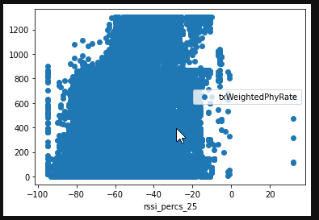
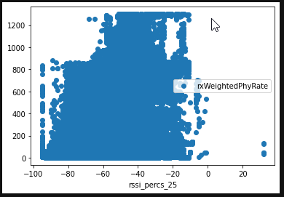
Evaluate Phy Rates at Different RSSI levels
Look at the RSSI levels (rssi_percs_25) and look at the spread of Tx and Rx weighted Phy Rate
As we can see from the above plot that the Tx Weighted Phy Rate has more data at 1000-1200 when compared to Rx Weighted Phy Rate at the same levels of RSSI.

Slide 3
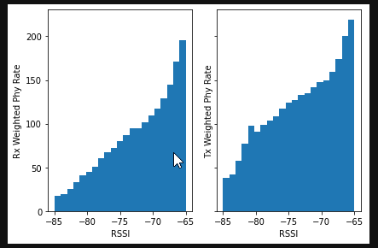
Produce a histogram (graph and CSV) for the average Tx and Rx Weighed Phy Rate between -85 and -65 dB in 1 dB steps
The spread of the data in the histogram is skewed as the Phy Rate is higher at the higher RSSI levels.

Slide 4
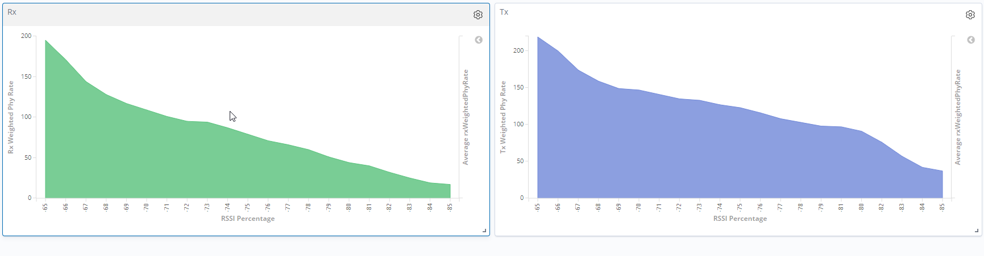
Create a pipeline design and spec for a data engineer, so it is possible to produce this as a graph in Grafana
Written a python code (Pipeline for data ingestion into Elasticsearch.ipynb) which will ingest the data into Elastic Search and which takes the input a csv file which has been generated from the previous histogram.

Slide 5
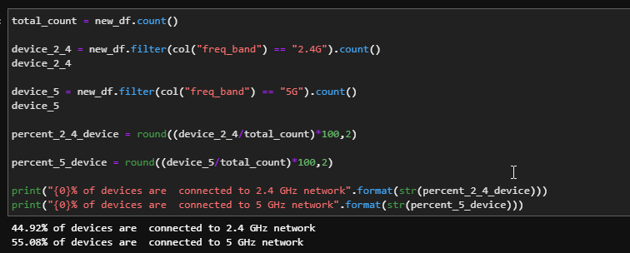
Evaluate RSSI threshold
Using the client stats sample data provided to you calculate what % of devices are connected to 2.4 GHz and 5 GHz ?
As we can see that the 44.92% of the devices are connected to the 2.4G Frequency Bands as 55.08% of the devices are connected to 5G frequency Bands before any Band steering has been implemented.

Slide 6
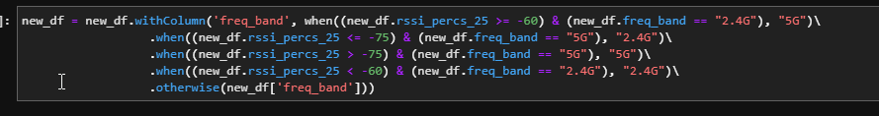
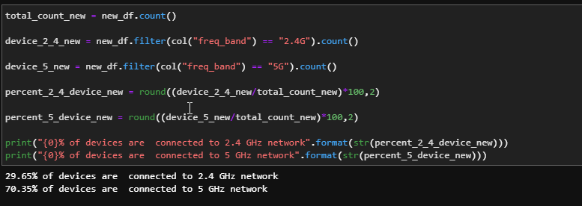
Band Steering feature
Calculate what % of devices that will be on 2.4GHz and 5GHz using Band Steering?
As we can see that the 29.65% of the devices are connected to the 2.4G Frequency Bands as 70.35% of the devices are connected to 5G frequency Bands after implementing Band steering.

Slide 7
Thank You!!

